Slide 1
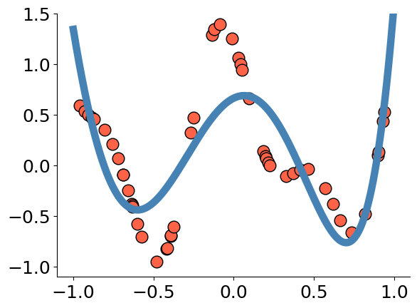
4 – Function Approximation and Supervised Learning

Slide 2

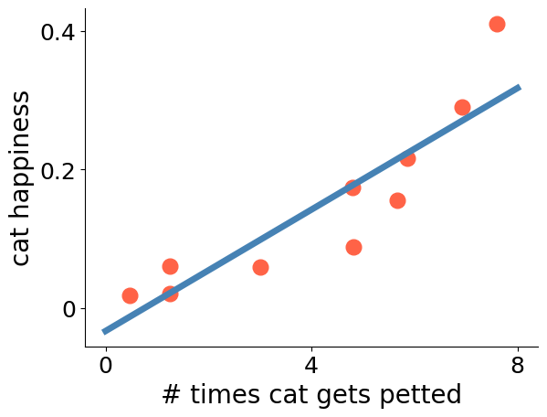



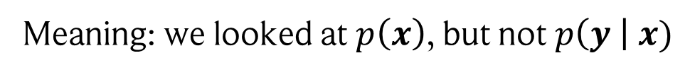
Motivation
So far, we did not discuss “labelled” data!
Meaning: we looked at $p\left(x\right)$, but not $p\left(y \right| x)$
Classification
Regression
$$x$$
$$y$$
Cat
Dog

Slide 3
Content
Hypothesis set and risk
Linear Regression
Polynomials
Universal function approximators
Weierstrass approximation theorem
Stone-Weierstrass theorem

Slide 4
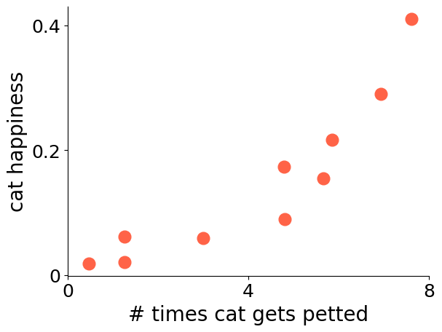



Fitting data: the hypothesis set
What is our usual setup?
We have $n$ data samples $(x_{i}, y_{i})$, where $x_{i}$ is a feature vector and $y_{i}$ whatever we want to predict!
Example:
$$(x_{10}, y_{10})$$
Task: For new, unlabelled data samples, we want to predict $y$!
We cannot try to fit all possible functions, so we restrict ourselves to a hypothesis set:
$$ℋ=$$
set of functions to explain the data
$$ℋ=\{x, { 2⋅x}^{2}\}$$
For example:
We can also have a whole span of functions:
$$ℋ=\left\{α+βx+γx^{2} \right| α,β,γ∈ℝ\}$$

Slide 5
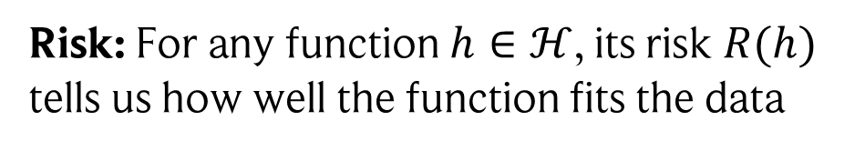
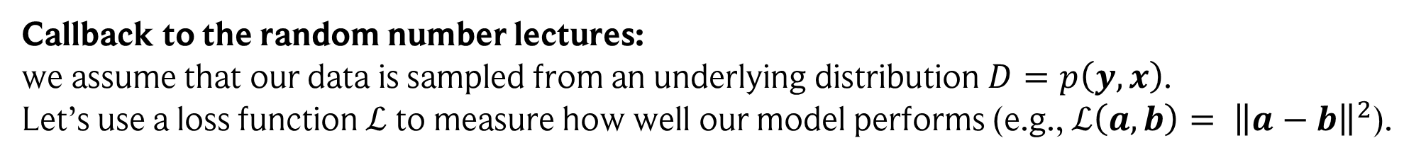

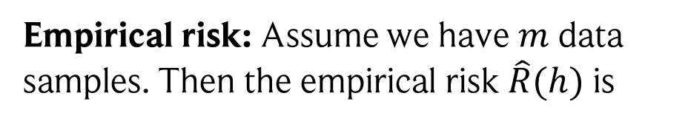
Empirical risk minimization
Callback to the random number lectures:
we assume that our data is sampled from an underlying distribution $D=p\left(y, x\right)$.
Let’s use a loss function $ℒ$ to measure how well our model performs (e.g.,$ℒ\left(a,b\right)= {\left\|a−b\right\|}^{2}$).
Risk: For any function $h∈ℋ$, its risk $R(h)$ tells us how well the function fits the data
Empirical risk: Assume we have $m$ data samples. Then the empirical risk $\hat{R}(h)$ is
$$\hat{R}\left(h\right)=\sum_{i=1}^{m}{ℒ\left(h\left(x_{i}\right), y_{i}\right)}$$
$$R\left(h\right)=E_{\left(x,y\right)∼D}\left[ℒ\left(h\left(x\right), y\right)\right]$$
Fitting the data: Find $\hat{h}∈ℋ$ that minimizes $\hat{R}:$
$$\hat{h}={argmin}_{h∈ℋ}\left(\hat{R}(h)\right)$$
The risk of our empirical risk minimizer is bounded by two terms:
$$R\left(\hat{h}\right)≤\sup_{h∈ℋ}\left|R\left(h\right)−\hat{R}\left(h\right)\right|+\inf_{g∈ℋ}{\hat{R}\left(g\right)}$$
How well does our fit work on the full data distribution?
How well can we fit the training data?
Generalization error
Interpolation error

Slide 6
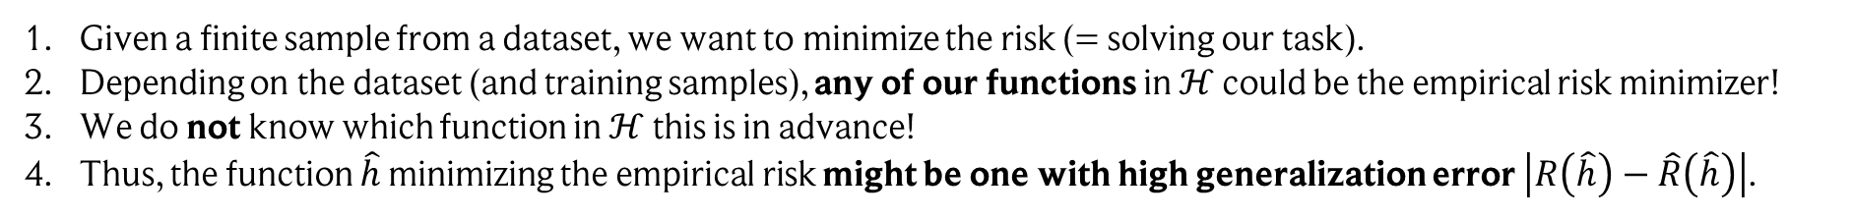
Why the supremum?
$$R\left(\hat{h}\right)≤\sup_{h∈ℋ}\left|R\left(h\right)−\hat{R}\left(h\right)\right|+\inf_{g∈ℋ}{\hat{R}\left(g\right)}$$
What is our aim?
Given a finite sample from a dataset, we want to minimize the risk (= solving our task).
Depending on the dataset (and training samples), any of our functions in $ℋ$ could be the empirical risk minimizer!
We do not know which function in $ℋ$ this is in advance!
Thus, the function $\hat{h}$ minimizing the empirical risk might be one with high generalization error $\left|R\left(\hat{h}\right)−\hat{R}\left(\hat{h}\right)\right|$.
To account for this, we use the supremum to bound the generalization error.
In other words: this is the worst generalization error we can get using a hypothesis in $ℋ$ (again, empirical risk minimization might select exactly such a “bad” function, as any function in $ℋ$ is allowed as a solution).
Note: this is a property of the whole set $ℋ$, i.e., shared by all functions in $ℋ$.
Also note: usually, there is a trade-off between generalization and interpolation error. However, both can be low if, for instance, our data is native to $ℋ.$E.g., if the underlying data relationship is linear, then linear functions will fit the training data well and generalize well to new data!

Slide 7
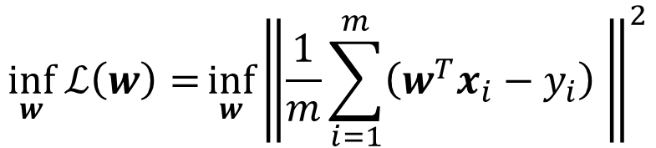
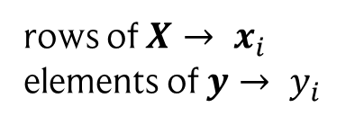

Example: linear regression
Let’s look at a concrete example: linear regression (your baseline for everything!)
In this case, we have $ℋ=\left\{w^{T}x \right| w∈ℝ^{N}\}$ , the set of all affine functions.
$$\inf_{w} ℒ\left(w\right)={\inf_{w}{\left\|\frac{1}{m}\sum_{i=1}^{m}{\left(w^{T}x_{i}−y_{i}\right) }\right\|}^{2}}$$
Empirical risk minimization gives us:
$$={\inf_{w}{\left\|\left(Xw−y\right)\right\|}^{2}}$$
rows of $X→ x_{i}$
elements of $y→ y_{i}$
This is solved using the gradients:
$$∇_{w}ℒ=X^{T}\left(Xw−y\right)=0 ↔ w={\left(X^{T}X\right)}^{−1}X^{T}y$$

Slide 8
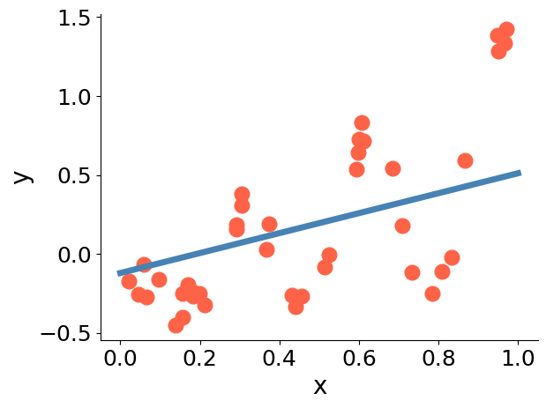
Example: linear regression

Slide 9
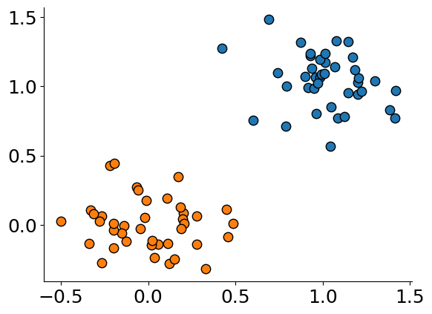
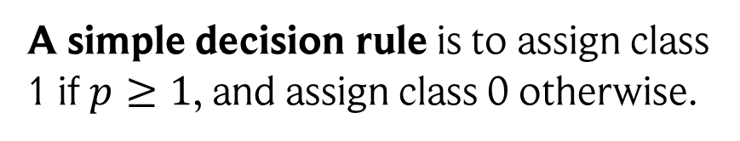
What about classification?
Very similar! In case of two classes, we model the probability of a data sample to belong to the first class by $p\left(x\right)=σ\left(b+w^{T}x\right)$ and to the second class $1−p\left(x\right).$
A simple decision rule is to assign class 1 if $p≥1$, and assign class 0 otherwise.

Slide 10
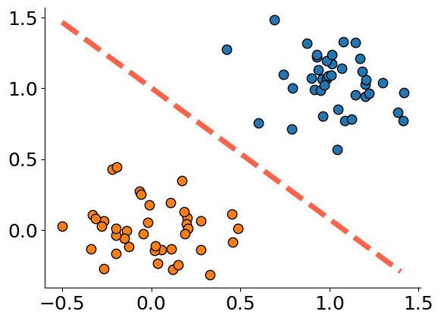



What about classification?
Very similar! In case of two classes, we model the probability of a data sample to belong to the first class by $p\left(x\right)=σ\left(b+w^{T}x\right)$ and to the second class $1−p\left(x\right).$
A simple decision rule is to assign class 1 if $p≥1$, and assign class 0 otherwise.
This is equivalent to:
Class 1: $b+w^{T}x≥0$
Class 2: $b+w^{T}x<0$
The class is given depending on which side of the hyperplane $w$ the sample lies!

Slide 11
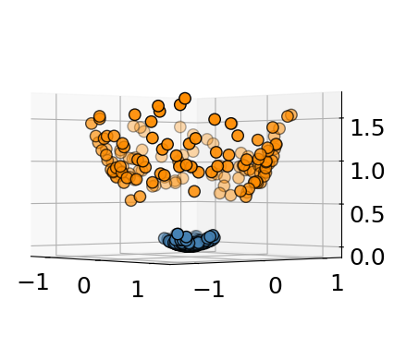
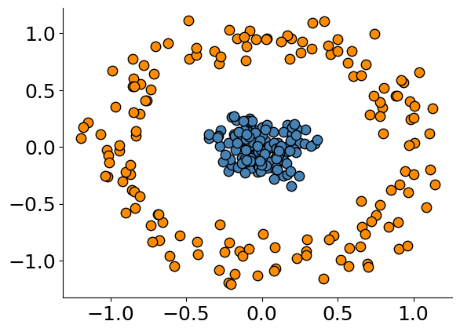





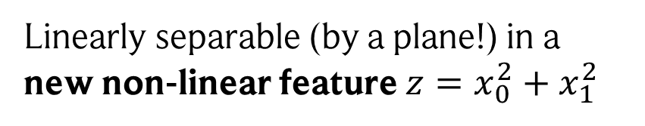
And… what now?!
Linearly separable (by a plane!) in a new non-linear feature $z=x_{0}^{2}+x_{1}^{2}$
$$z$$
$$x_{1}$$
$$x_{0}$$
$$x_{1}$$
$$x_{0}$$

Slide 12
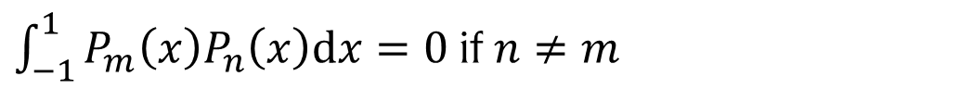
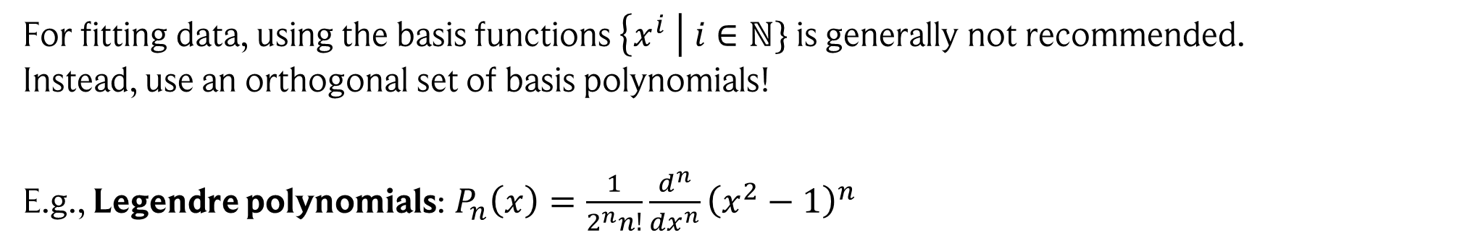
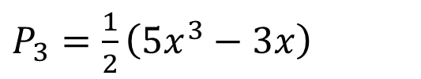
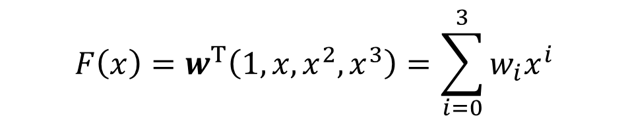
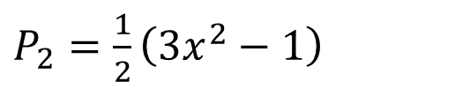


Polynomial regression
$$F\left(x\right)=w^{T}\left(1, x, x^{2}, x^{3}\right)=\sum_{i=0}^{3}{w_{i}x^{i}}$$
Use non-linear transformations of the features:
Third-degree polynomial
For fitting data, using the basis functions $\left\{x^{i} \right| i∈ℕ\}$ is generally not recommended.
Instead, use an orthogonal set of basis polynomials!
E.g., Legendre polynomials: $P_{n}\left(x\right)=\frac{1}{2^{n}n!}\frac{d^{n}}{dx^{n}}{\left(x^{2}−1\right)}^{n}$
$$P_{0}=1$$
$P_{2}=\frac{1}{2}\left(3x^{2}−1\right)$
$$P_{1}=x$$
$P_{3}=\frac{1}{2}\left(5x^{3}−3x\right)$
These basis polynomials satisfy:
$\int_{−1}^{1}{P_{m}\left(x\right)P_{n}\left(x\right)dx}=0$ if $n≠m$

Slide 13
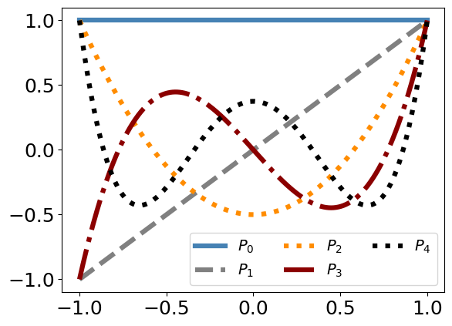
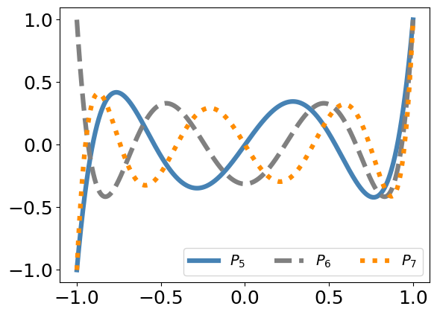
Some example Legendre polynomials

Slide 14
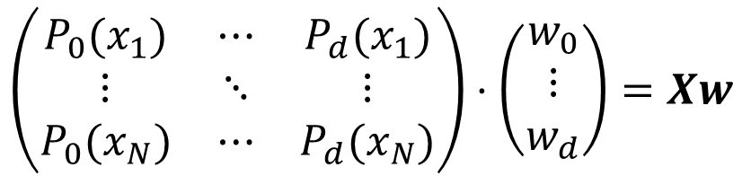

Fitting data using polynomials
This is exactly like linear regression, just with different “data features”.
Assume the case of $N$ one-dimensional data features $x∈\left[−1, 1\right].$ Then our regression model is:
$$\left(\begin{matrix}P_{0}(x_{1}) & ⋯ & P_{d}(x_{1}) \\ ⋮ & ⋱ & ⋮ \\ P_{0}(x_{N}) & ⋯ & P_{d}(x_{N})\end{matrix}\right)⋅\left(\begin{matrix}w_{0} \\ ⋮ \\ w_{d}\end{matrix}\right)=Xw$$
$${\left(Xw\right)}_{k}=\sum_{i=0}^{d}{w_{i}P_{i}\left(x_{k}\right)}$$
or
where $d$ is the degree of the polynomial we use. We can find a solution again using:
$$w={\left(X^{T}X\right)}^{−1}X^{T}y$$
Note: we could also use any other function as basis functions here, not just polynomials!

Slide 15
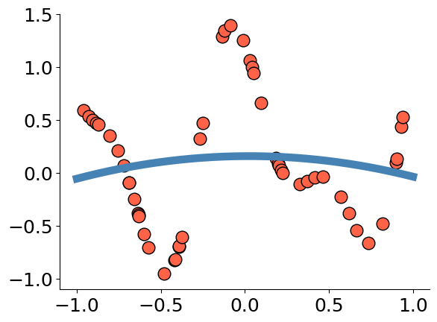


Results for different degrees
$$d=2$$
$$d=5$$

Slide 16
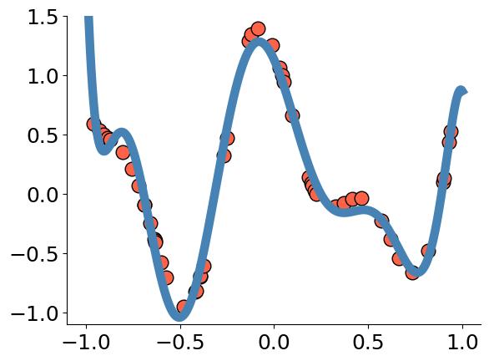
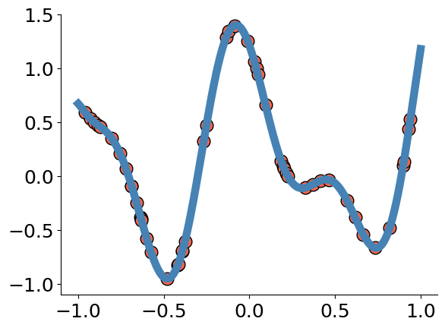


Results for different degrees
$$d=9$$
$$d=15$$

Slide 17

Why polynomials? Universal function approximation
Let $d∈ℕ$. A set of functions $ℋ$ from $ℝ^{d}$ to $ℝ$ is a universal approximator if
for every $ε>0$, “any error”
every compact $K⊂ℝ^{d}$, “no matter which inputs”
and every continuous function $f: ℝ^{d}→$ $ℝ,$ “no matter which function”
there exists $g∈ℋ$ such that:
$$\sup_{x∈K}\left|f\left(x\right)−g(x)\right|<ε$$
Thus, a universal approximator can approximate a continuous function
everywhere up to any error!

Slide 18
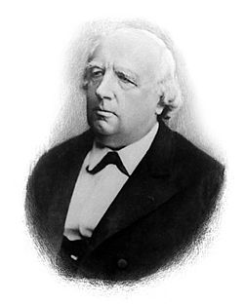
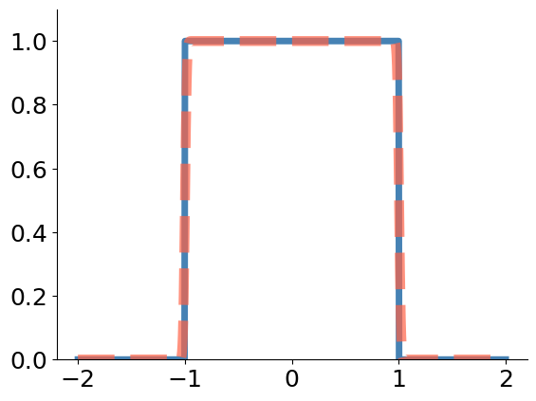

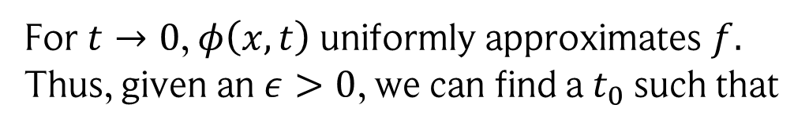
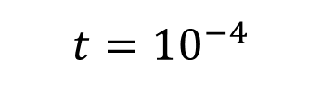
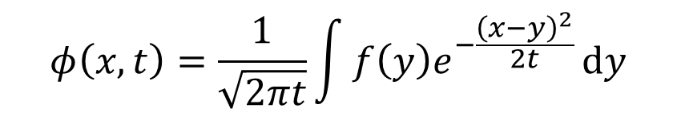
Weierstrass approximation theorem
The set of all polynomials (of all degrees) is a universal approximator.
Karl Weierstrass
(1815-1897)
We will sketch the proof here, which is quite short and uses only two major ideas!
First, we “smear” out the actual function $f$ we would like to approximate using:
$$t={10}^{−4}$$
$$φ\left(x,t\right)=\frac{1}{\sqrt{2πt}}\int{f\left(y\right)e^{−\frac{{\left(x−y\right)}^{2}}{2t}}}dy$$
For $t→0$, $φ\left(x,t\right)$ uniformly approximates $f.$ Thus, given an $ε>0$, we can find a $t_{0}$ such that
$$\left|φ\left(x,t_{0}\right) −f(x)\right|<\frac{ε}{2}$$

Slide 19
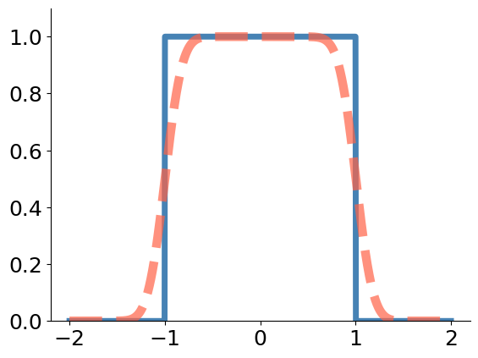

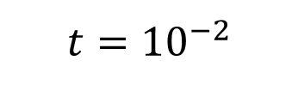

Weierstrass approximation theorem
The set of all polynomials (of all degrees) is a universal approximator.
Karl Weierstrass
(1815-1897)
We will sketch the proof here, which is quite short and uses only two major ideas!
First, we “smear” out the actual function $f$ we would like to approximate using:
$$t={10}^{−2}$$
$$φ\left(x,t\right)=\frac{1}{\sqrt{2πt}}\int{f\left(y\right)e^{−\frac{{\left(x−y\right)}^{2}}{2t}}}dy$$
$$φ$$
For $t→0$, $φ\left(x,t\right)$ uniformly approximates $f.$ Thus, given an $ε>0$, we can find a $t_{0}$ such that
$$f$$
$$\left|φ\left(x,t_{0}\right) −f(x)\right|<\frac{ε}{2}$$

Slide 20
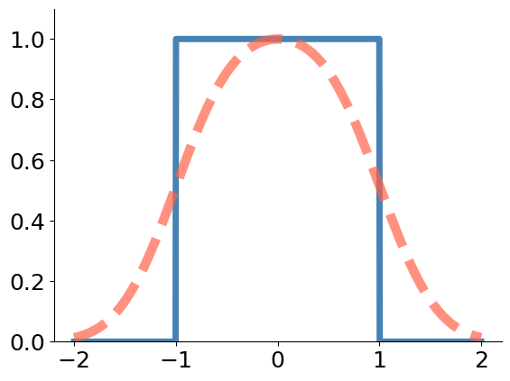
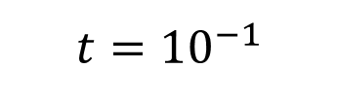
Weierstrass approximation theorem
The set of all polynomials (of all degrees) is a universal approximator.
Karl Weierstrass
(1815-1897)
We will sketch the proof here, which is quite short and uses only two major ideas!
First, we “smear” out the actual function $f$ we would like to approximate using:
$$t={10}^{−1}$$
$$φ\left(x,t\right)=\frac{1}{\sqrt{2πt}}\int{f\left(y\right)e^{−\frac{{\left(x−y\right)}^{2}}{2t}}}dy$$
$$φ$$
For $t→0$, $φ\left(x,t\right)$ uniformly approximates $f.$ Thus, given an $ε>0$, we can find a $t_{0}$ such that
$$f$$
$$\left|φ\left(x,t_{0}\right) −f(x)\right|<\frac{ε}{2}$$

Slide 21
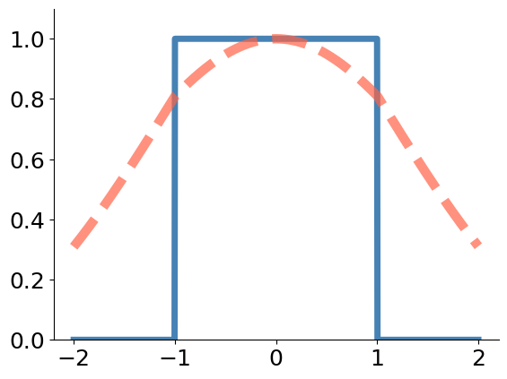

Weierstrass approximation theorem
The set of all polynomials (of all degrees) is a universal approximator.
Karl Weierstrass
(1815-1897)
We will sketch the proof here, which is quite short and uses only two major ideas!
First, we “smear” out the actual function $f$ we would like to approximate using:
$$t=1$$
$$φ\left(x,t\right)=\frac{1}{\sqrt{2πt}}\int{f\left(y\right)e^{−\frac{{\left(x−y\right)}^{2}}{2t}}}dy$$
$$φ$$
For $t→0$, $φ\left(x,t\right)$ uniformly approximates $f.$ Thus, given an $ε>0$, we can find a $t_{0}$ such that
$$f$$
$$\left|φ\left(x,t_{0}\right) −f(x)\right|<\frac{ε}{2}$$

Slide 22
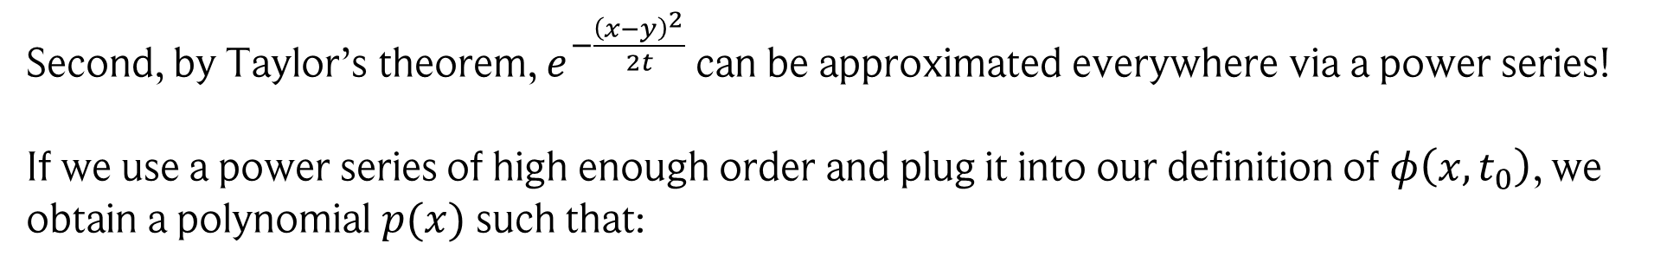

Weierstrass approximation theorem
The set of all polynomials (of all degrees) is a universal approximator.
Karl Weierstrass
(1815-1897)
We will sketch the proof here, which is quite short and uses only two major ideas!
Second, by Taylor’s theorem, $e^{−\frac{{\left(x−y\right)}^{2}}{2t}}$ can be approximated everywhere via a power series!
If we use a power series of high enough order and plug it into our definition of $φ\left(x,t_{0}\right)$, we obtain a polynomial $p(x)$ such that:
$$\left|φ\left(x,t_{0}\right) −p\left(x\right)\right|≤\frac{ε}{2}$$
$$\left|f(x) −p\left(x\right)\right|<\left|f\left(x\right)−φ\left(x,t_{0}\right)\right|+\left|φ\left(x,t_{0}\right)−p(x)\right|<ε$$
And thus:
There is an alternative proof by Bernstein using Bernstein polynomials which is really cool as well!

Slide 23
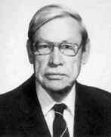

Stone-Weierstrass theorem
Generalization of the previous theorem!
Marshall Harvey Stone (1903 - 1989)
Let $d∈ℕ,$ let $K⊂$ $ℝ^{d}$ be compact, and let our hypothesis set of continuous functions $ℋ$ from $ℝ^{d}$ to $ℝ$ satisfy that
for all $x∈$ $K$, there exists $f∈$ $ℋ$ such that $f\left(x\right)≠0$,
for all $x≠y∈K$ , there exists $f∈ℋ$such that $f\left(x\right)≠f(y)$,
$ℋ$ is an algebra of functions, i.e., closed under addition, multiplication, and multiplication with scalars*.
Then $ℋ$ is a universal approximator.
This is a great tool: just check the criteria if you wanna know if $ℋ$ is a universal approximator!
*By closed, we mean: if $f,g∈ℋ$ and $α∈ℝ$, then $f+g∈ℋ$, $f⋅g∈ℋ$, and $α⋅f,α⋅g∈ℋ$

Slide 24





Exercise
Using Stone-Weierstrass, explain which of the following hypothesis sets are universal approximators:
Linear regression (linear in the features)
Polynomials
Decision Trees
Helpful illustration of a decision tree:
$$y_{3}$$
$$x_{2}$$
$$y_{1}$$
$$y_{2}$$
$$x_{1}$$

